Slide 1

Bounding
John Nganga

Slide 2
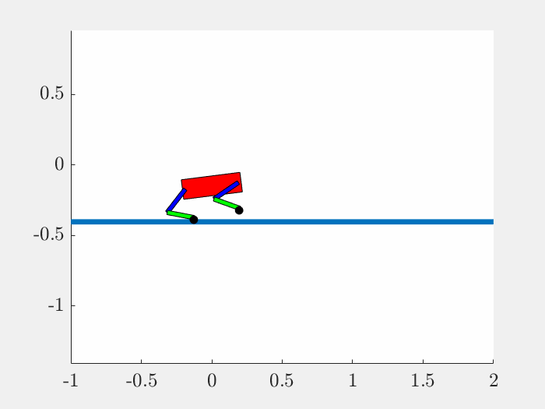
Motion
iLQR
DDP

Slide 3
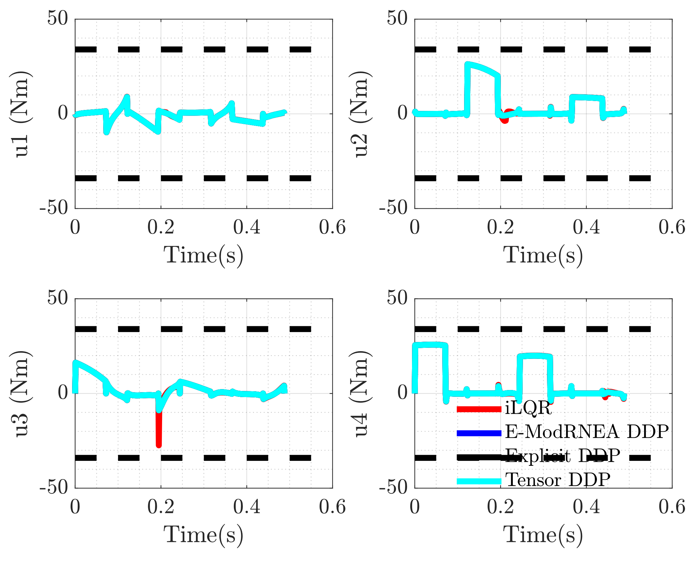
Control

Slide 4
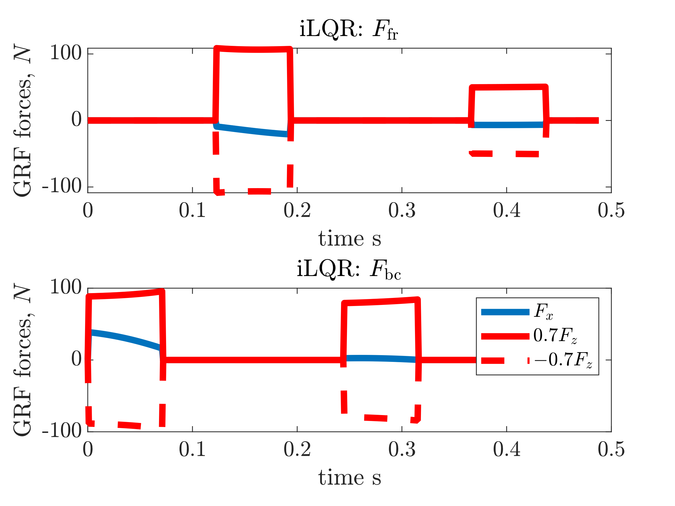
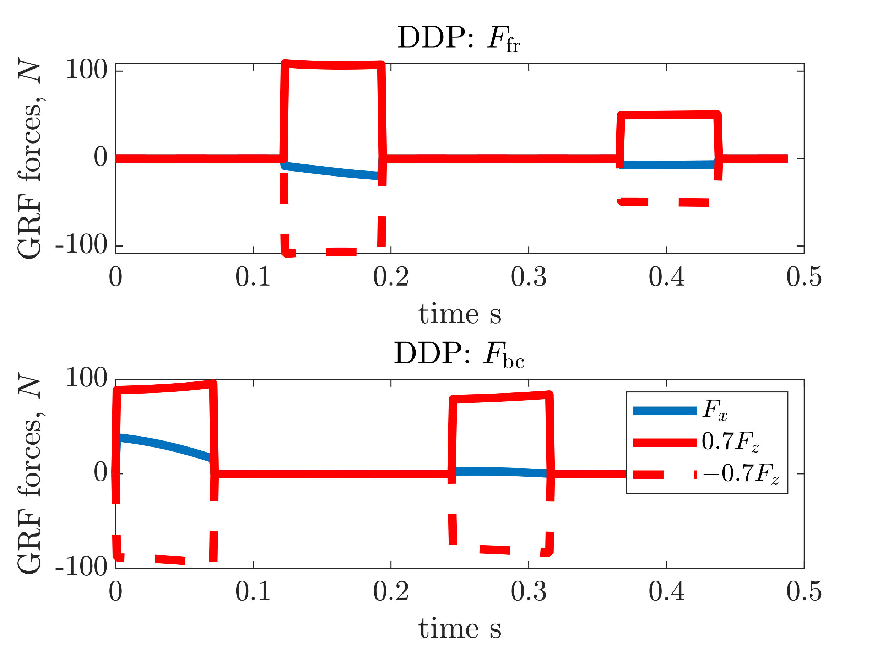
GRFs

Slide 5
Full Run with Noise

Slide 6
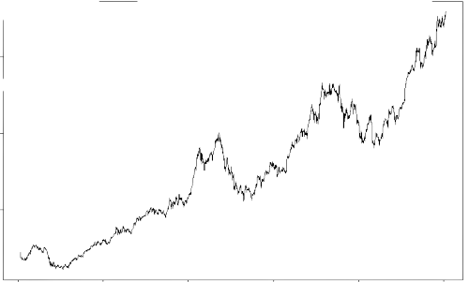
Add Noise to Trajectory
Trajectory
Control
Initial
Intermediate
Optimal
Trajectory
Control
Noise * Large Scalar
Run either iLQR/DDP to convergence

Slide 7
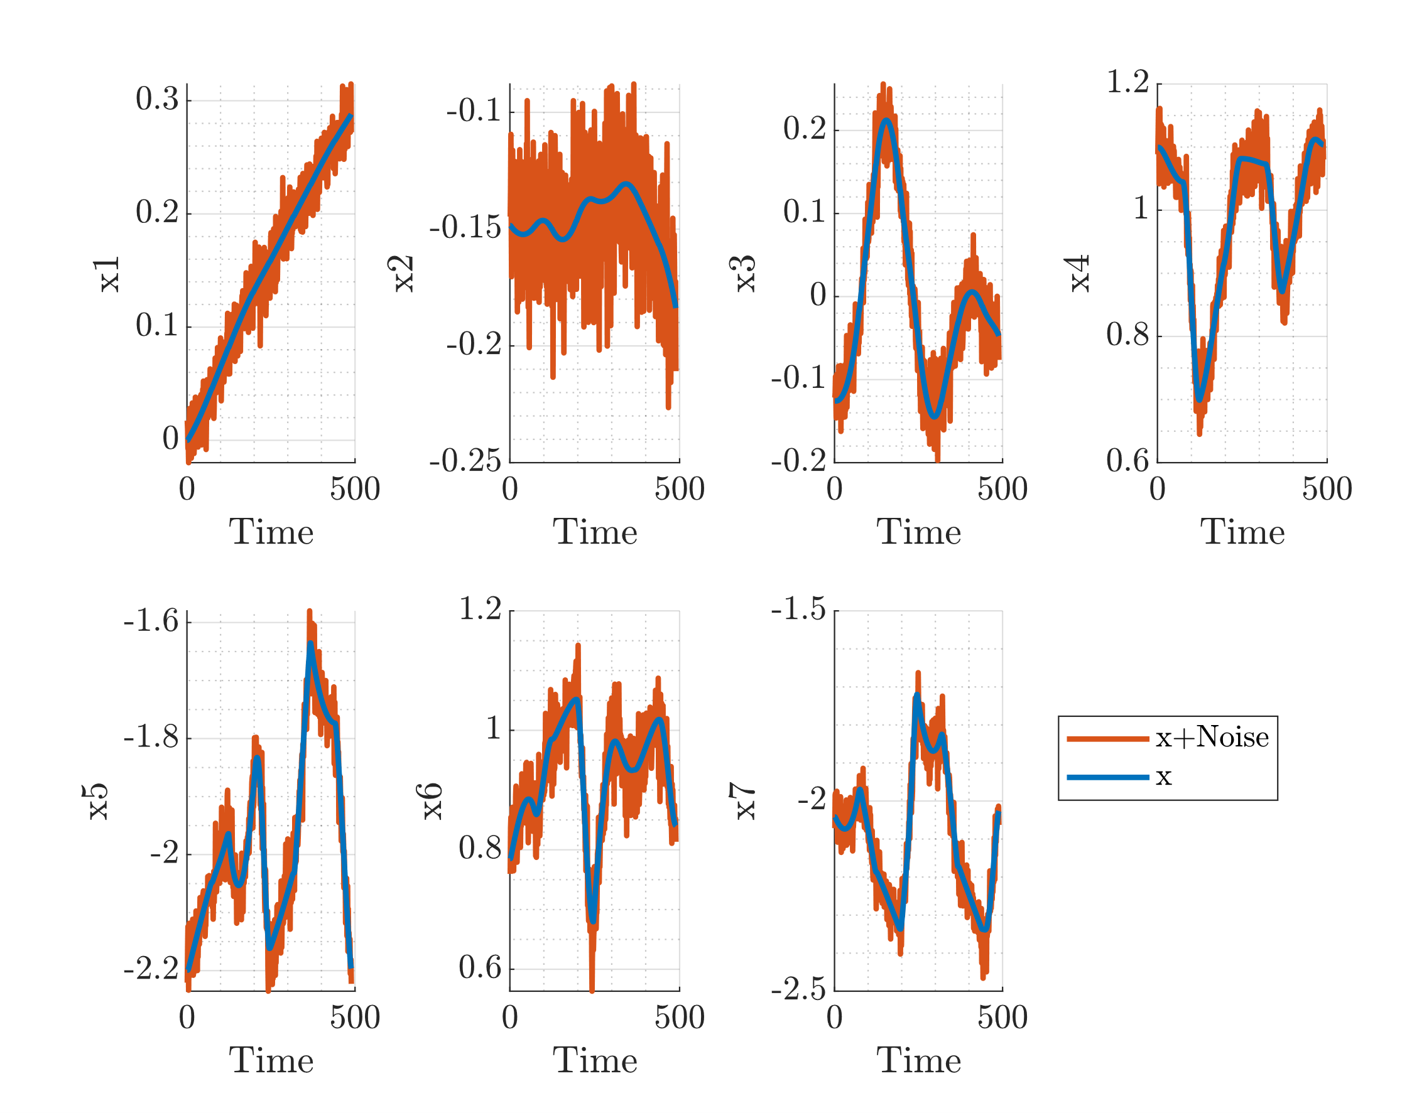
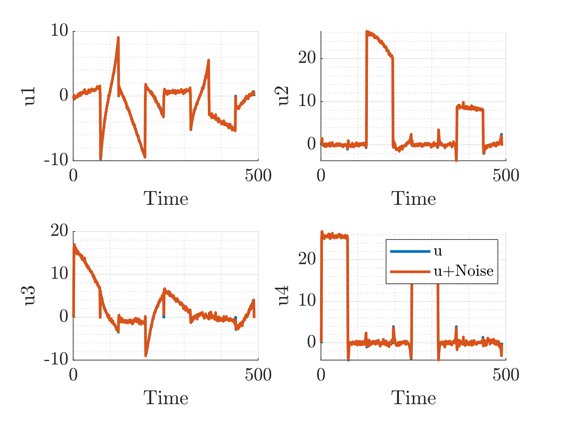
Add Noise Realization
State
Control
More noise on control didn’t lead to good trajectory (motion)

Slide 8
Resulting Motions
iLQR
DDP
Similar motion after noising up state/control and running optimization

Slide 9
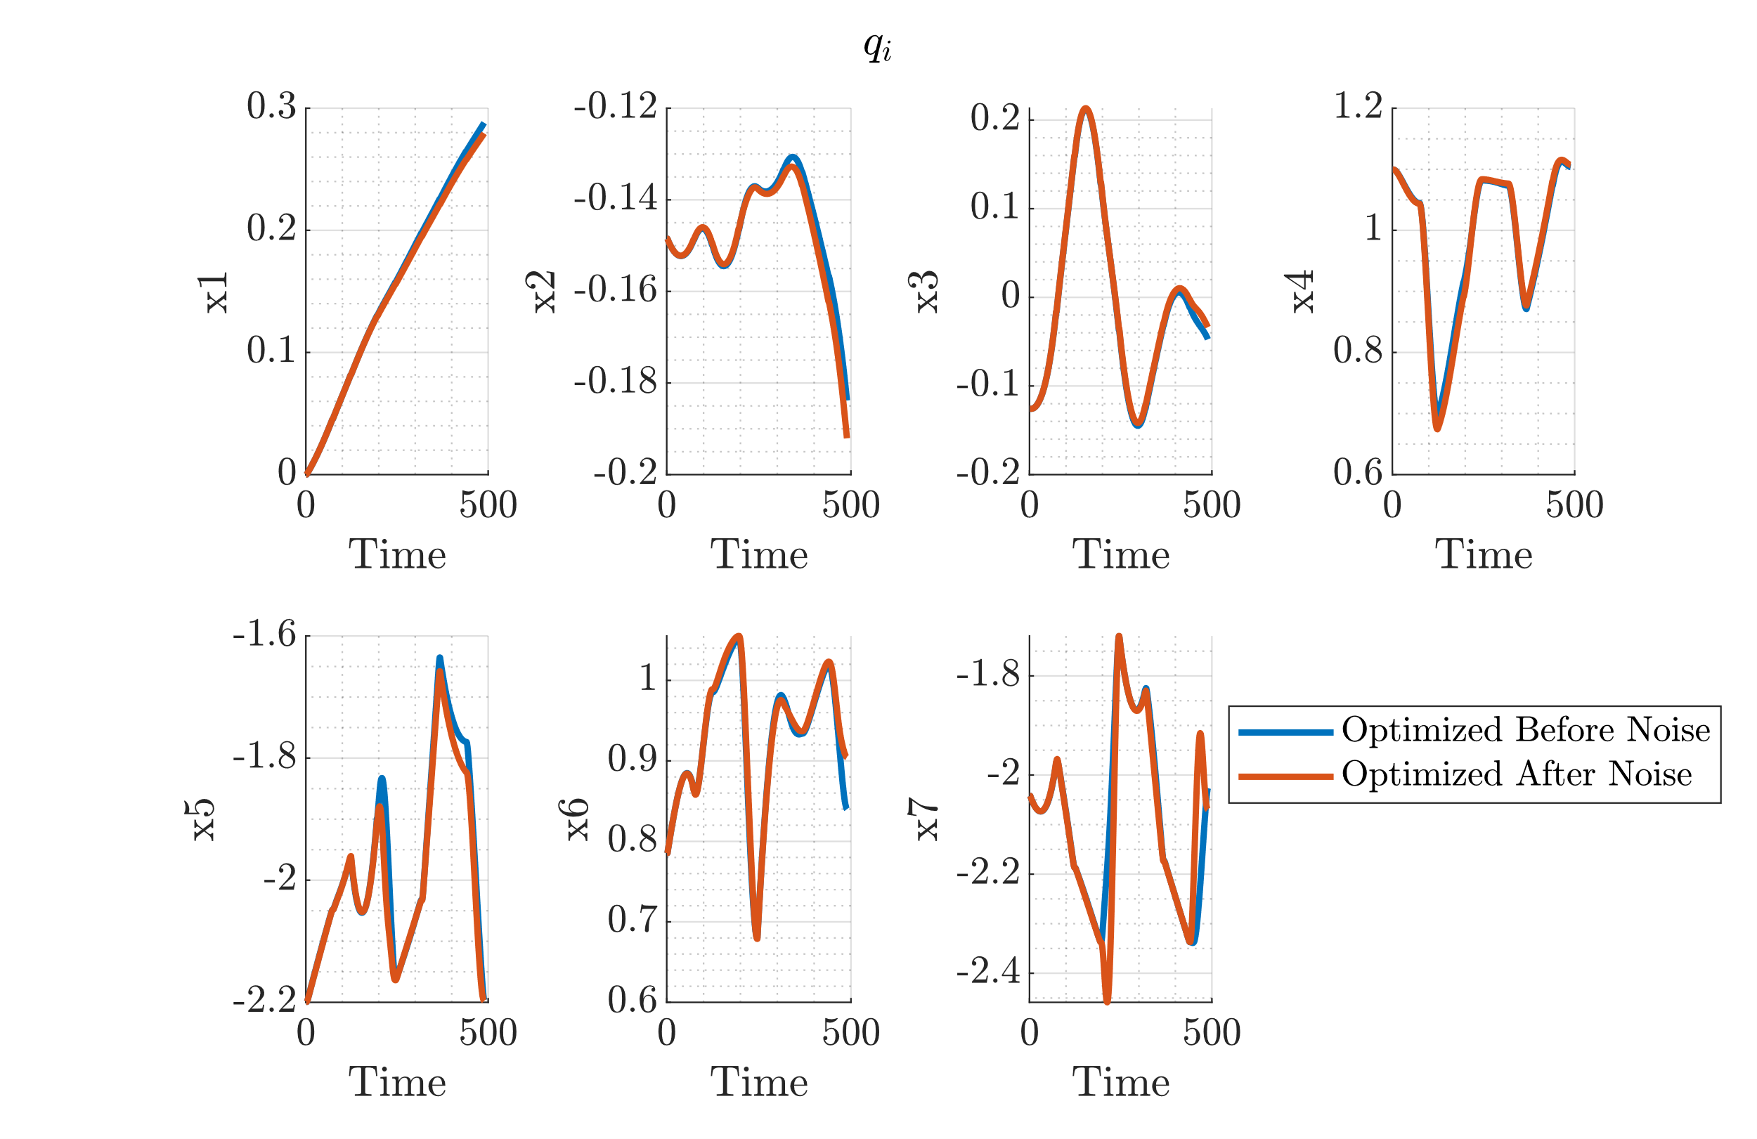
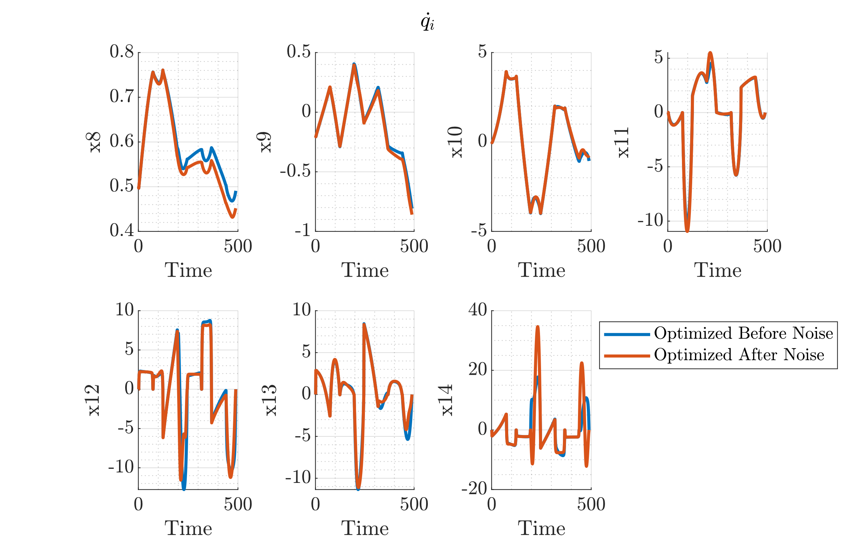
States after Optimization

Slide 10
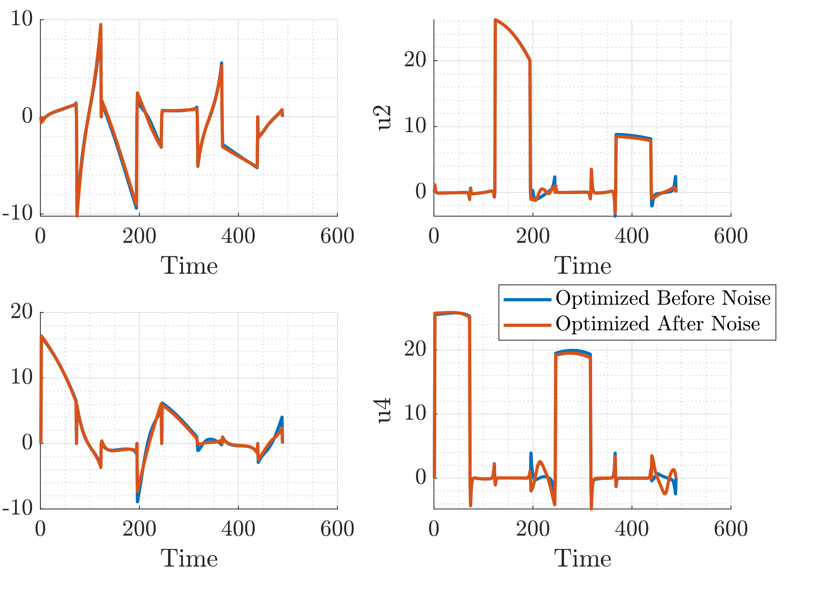
Control After Optimization

Slide 11
Adding Regularization to iLQR
Motivation
For convex cost function
DDP does regularization
iLQR does not need to do that regularization
This is an undue timing hit for DDP as compared to iLQR
Introduce a non-convex cost function to remove this undue timing on DDP
Cost function

Slide 12
Aside: Suboptimality/Convergence

Slide 13
Start Simple
Take sequences that have linear/quadratic convergent behavior
Plot their qualitative behavior
Suboptimality
Convergence behavior
Will allow interpretation of other plots

Slide 14
Definitions
Definition 1
Definition 2

Slide 15
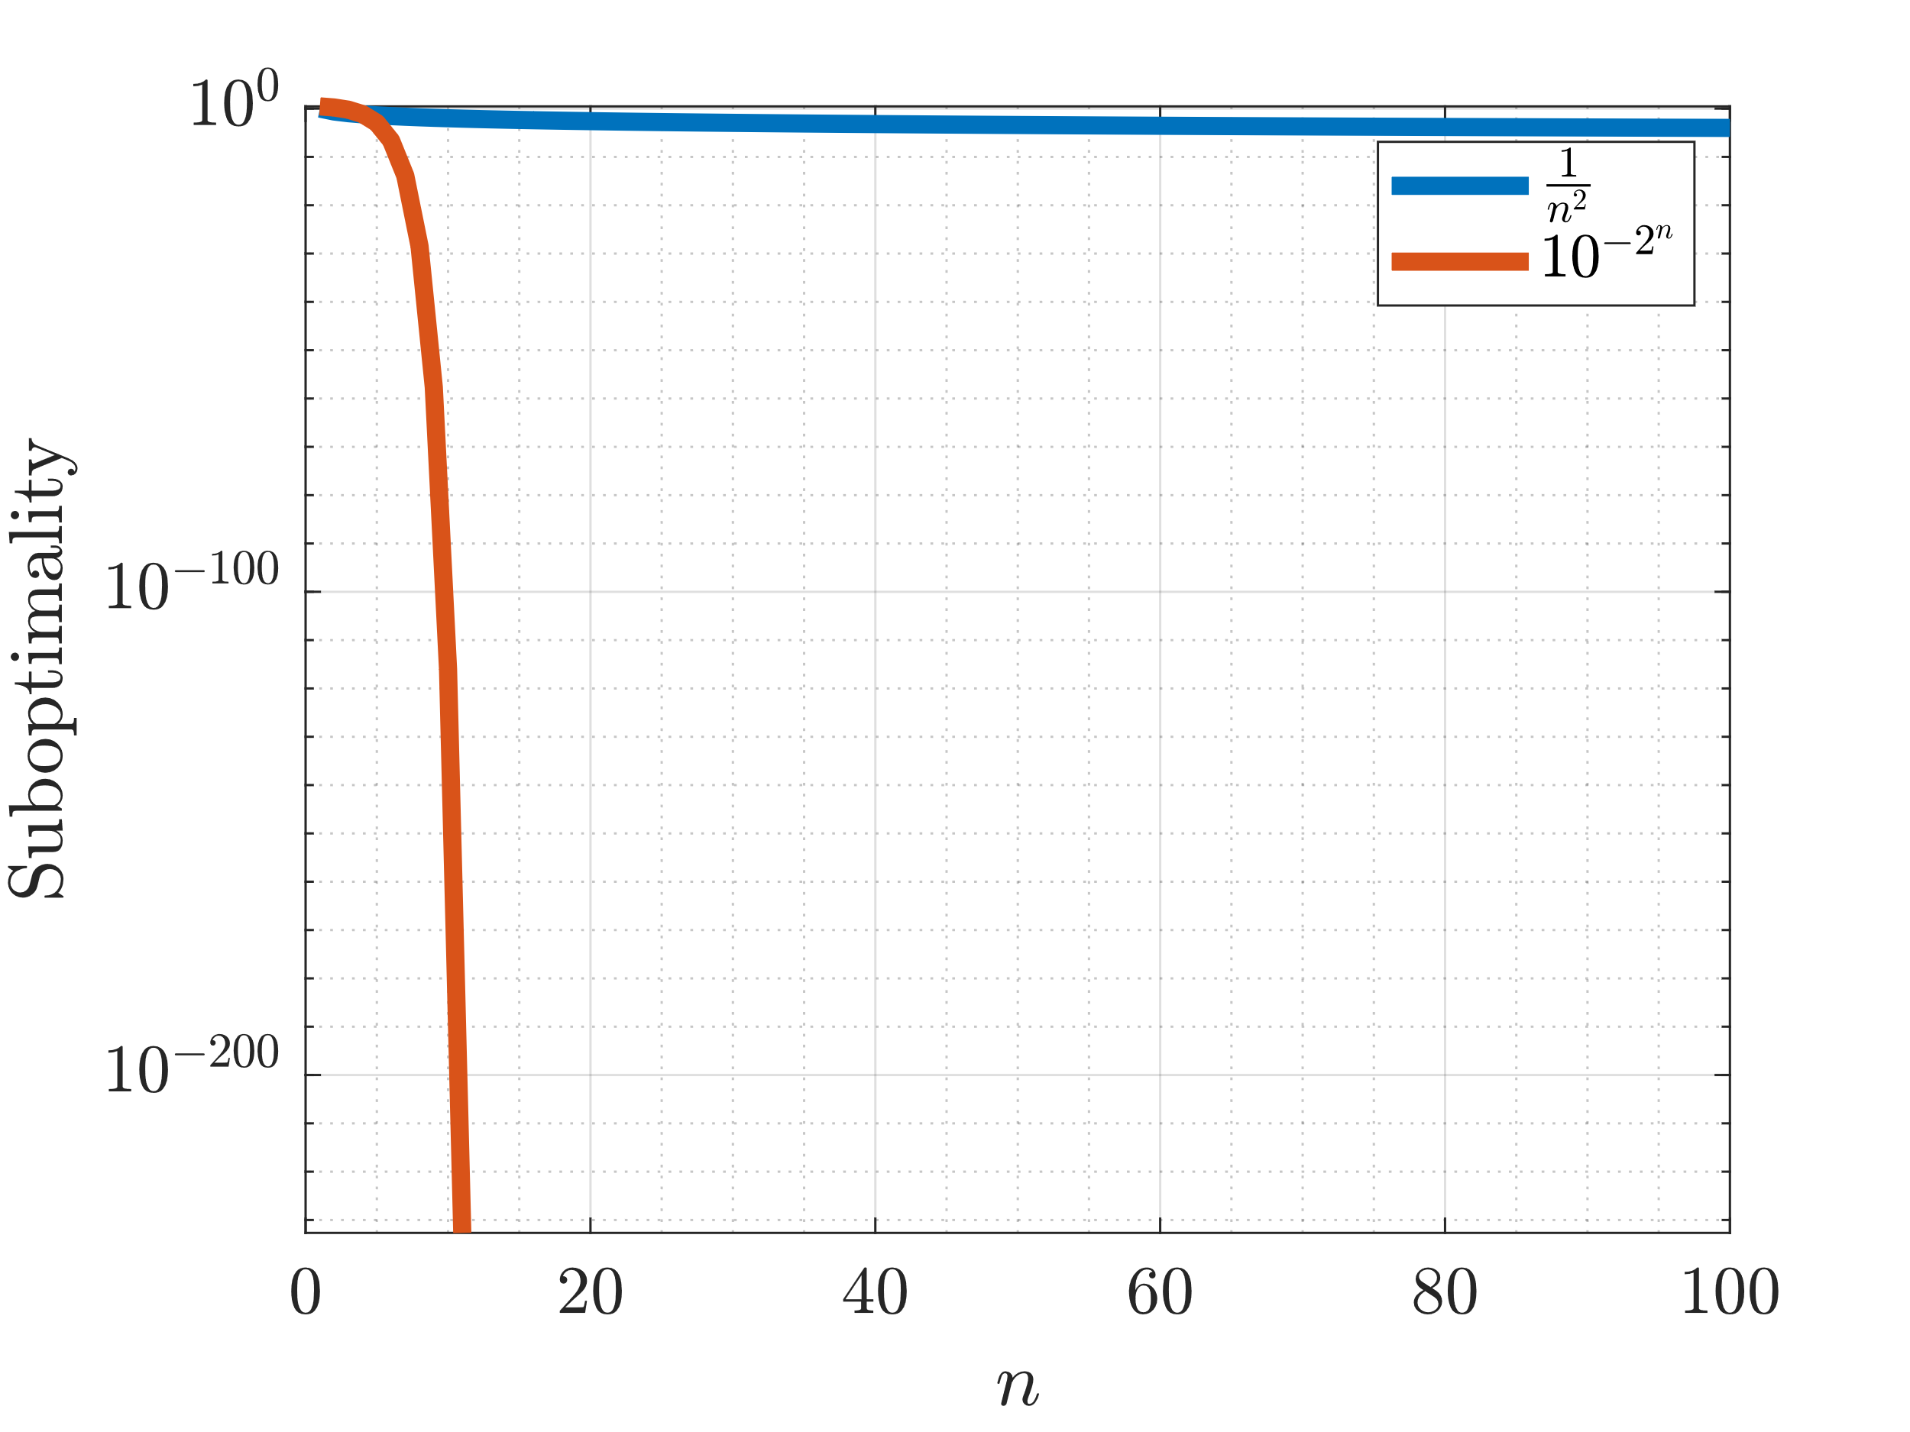
Sub-optimality: Simple functions

Slide 16
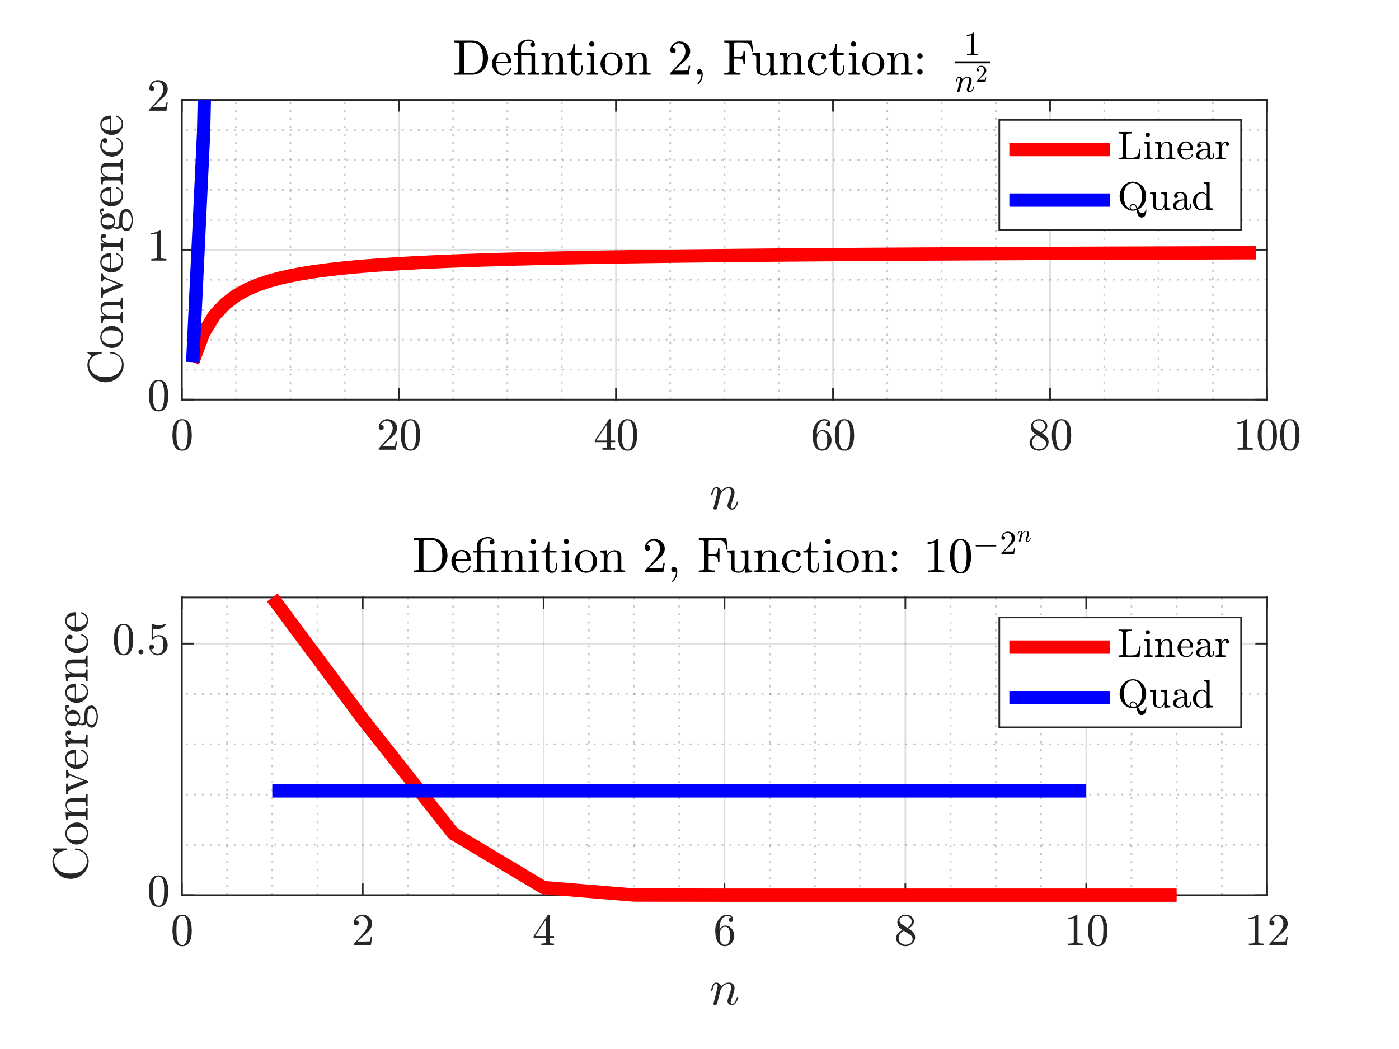
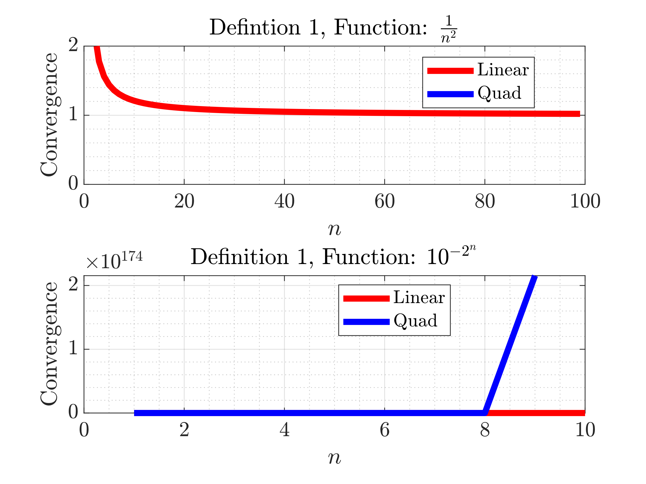
Convergence: Simple functions

Slide 17
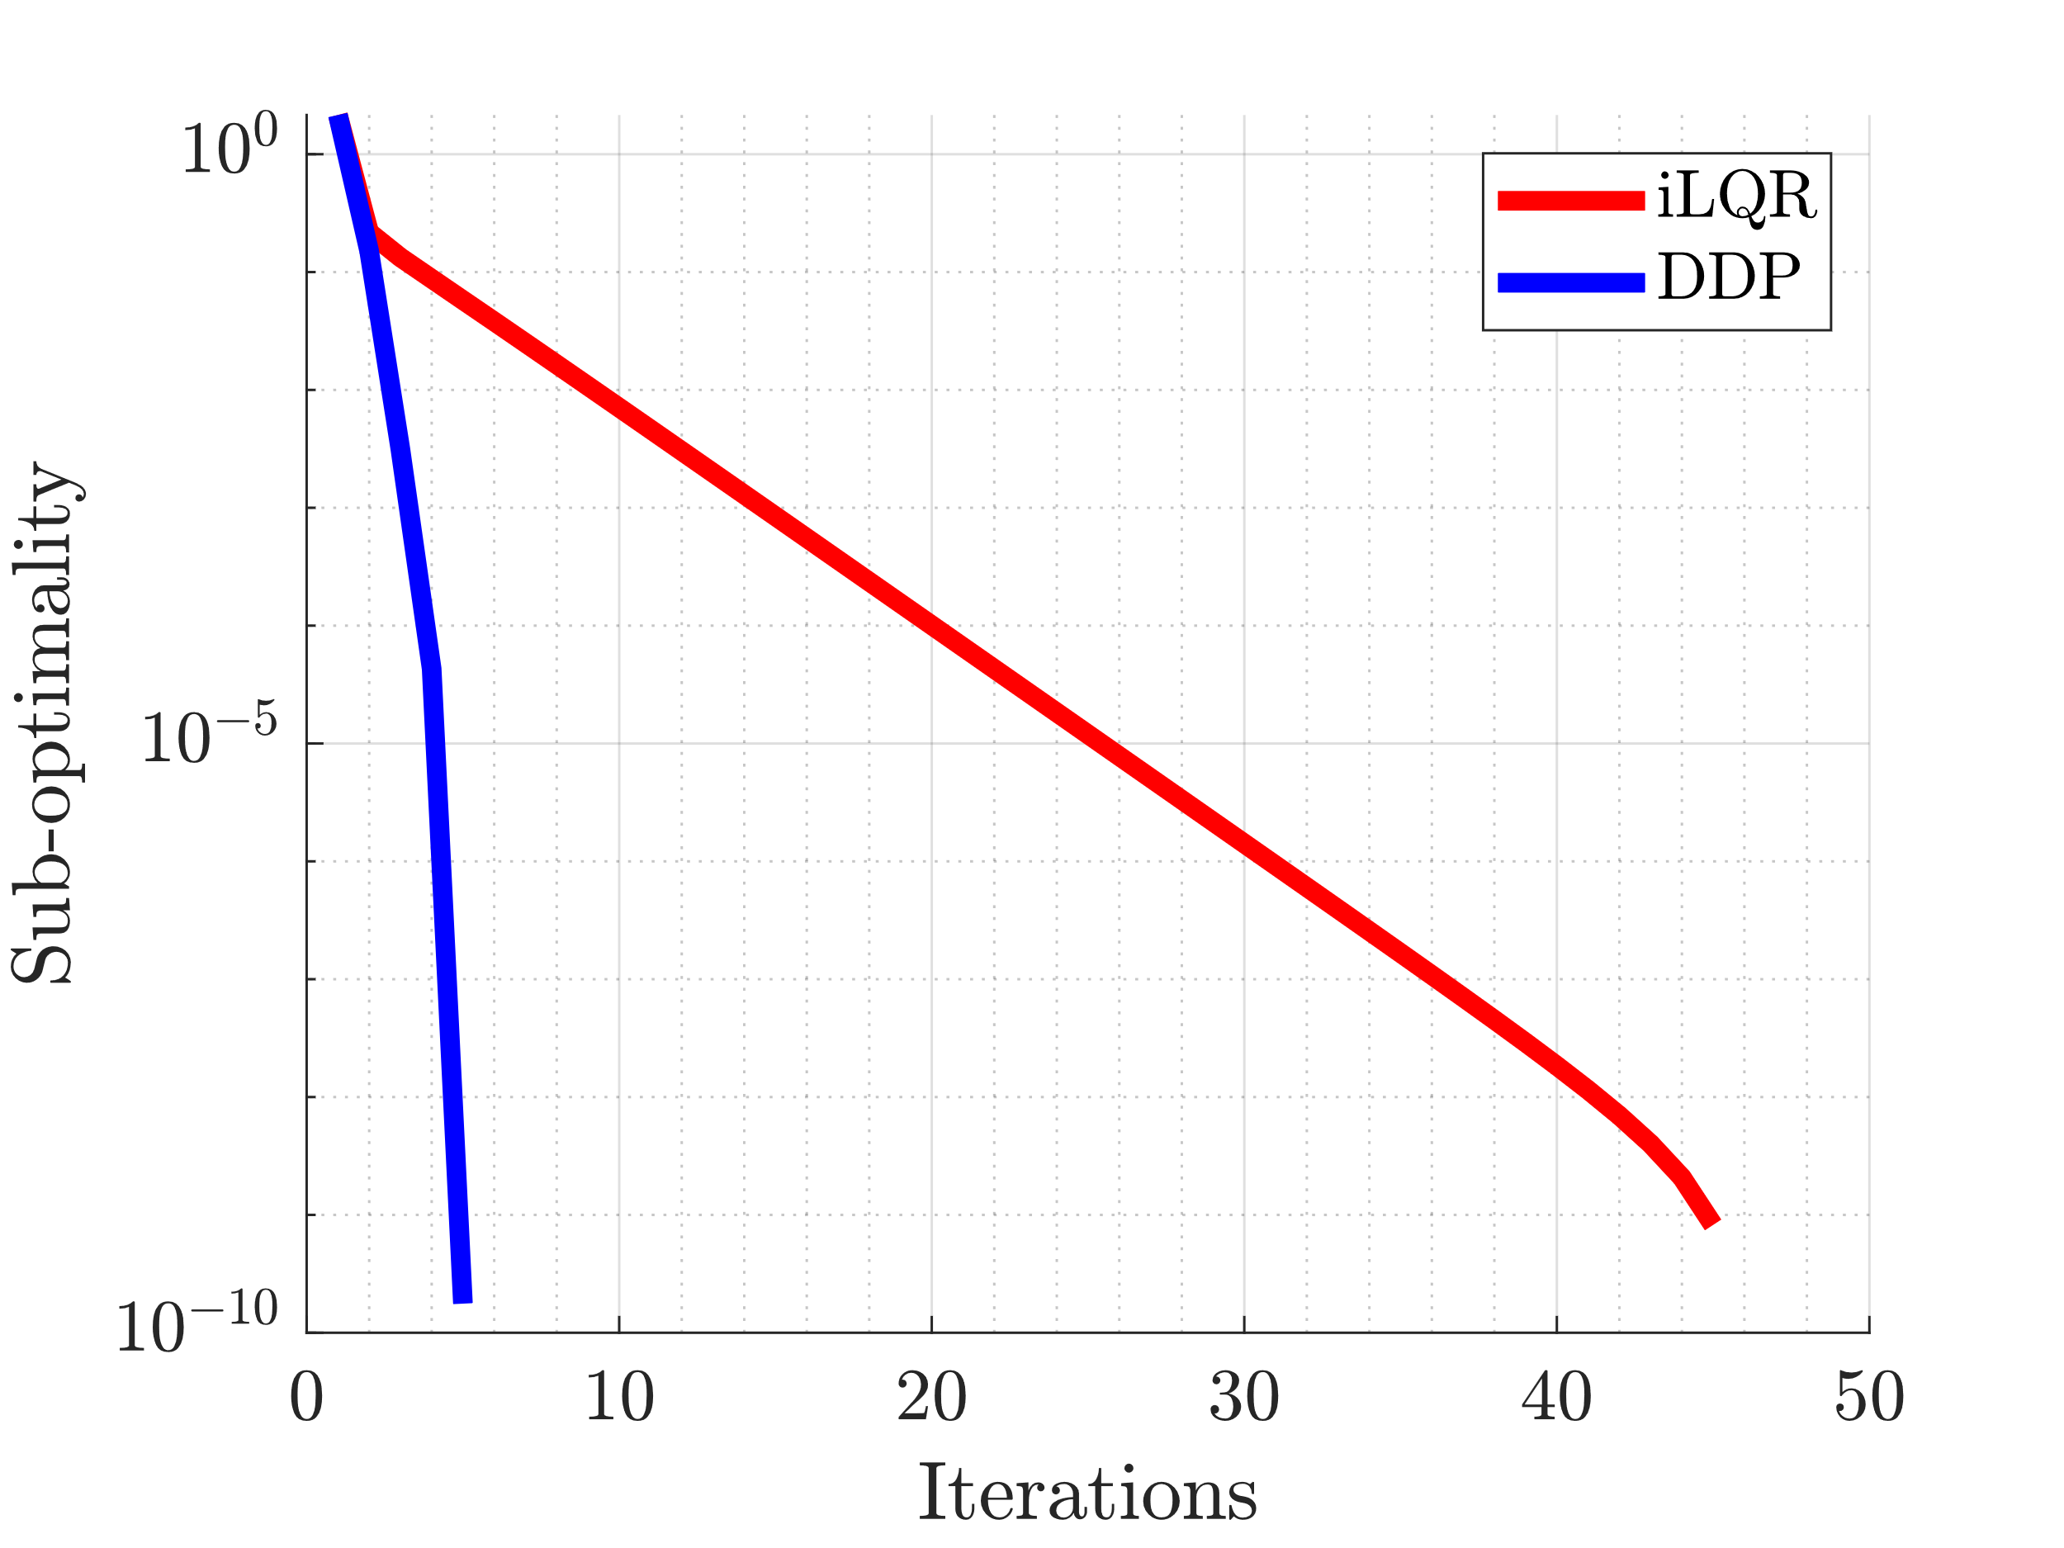
Suboptimality : Pendulum
Consider driving a pendulum to the upright position using iLQR/DDP

Slide 18
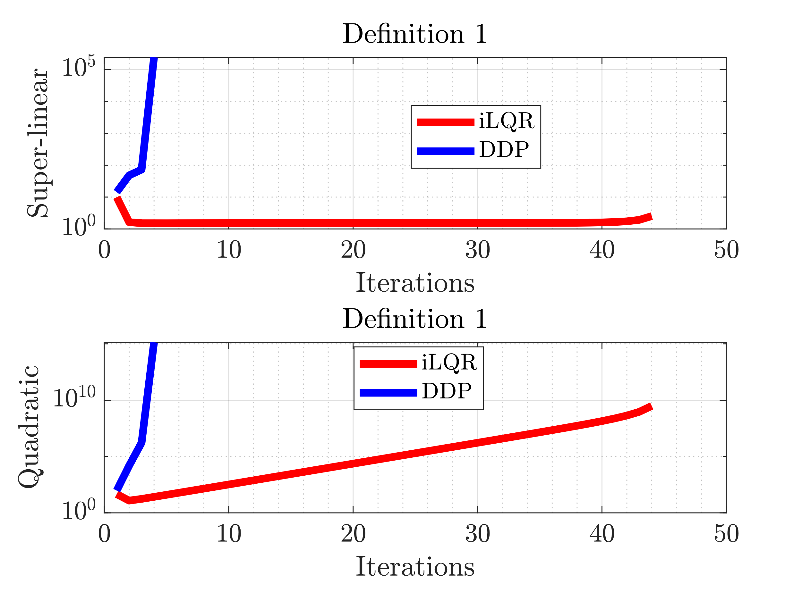
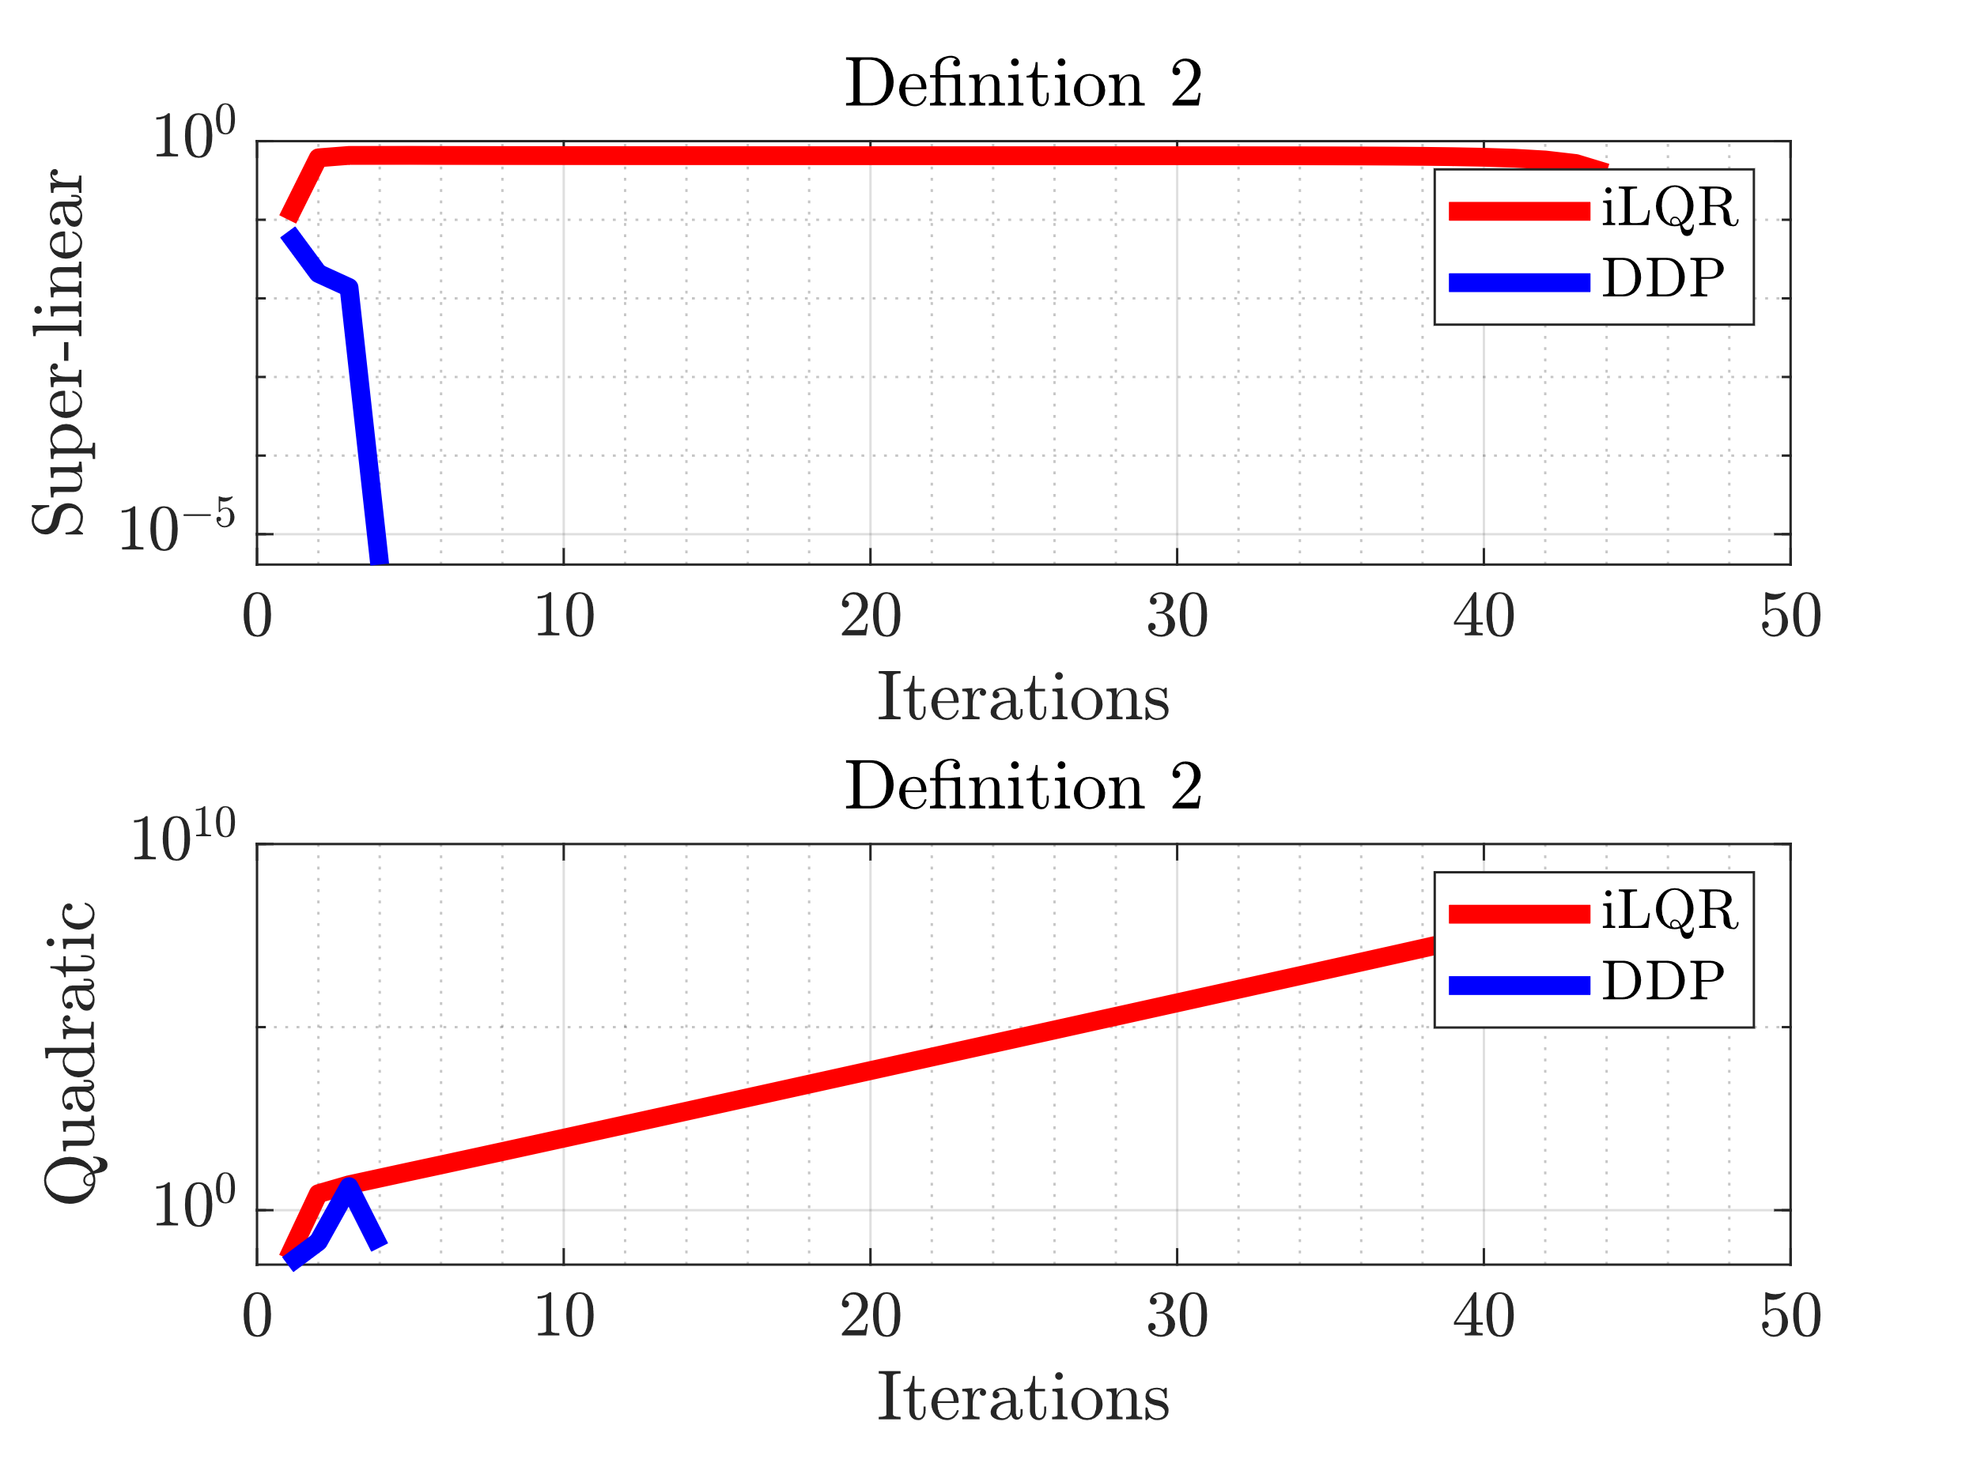
Convergence: Pendulum

Slide 19
Back to our case

Slide 20
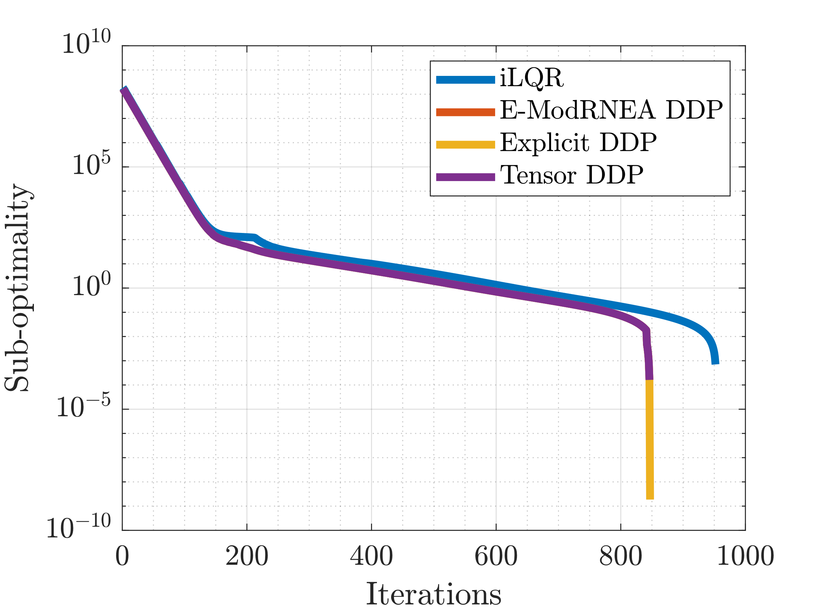
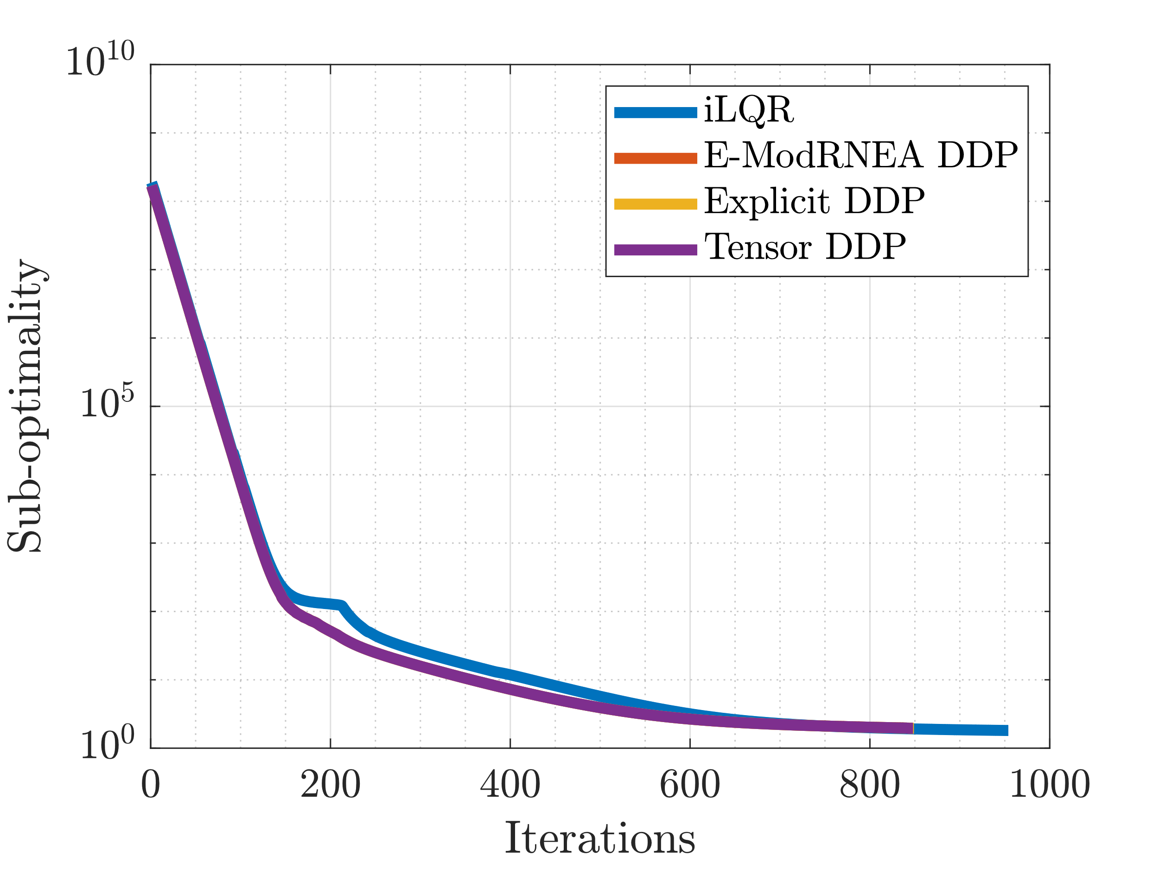
Sub-Optimality
Comparison with self
H = V – V ⃰ = V - Voptimal,achieved,afternoise`
Comparison with previous optimal
H = V – V ⃰ = V– Voptimal,achieved,beforenoise
V achieved previously: 4720871.72, Run for 5 AL updates, Tolerance: 1e-4
V achieved after noise: 4720869.76, Run for 1000 iterations, Tolerance: 1e-9

Slide 21
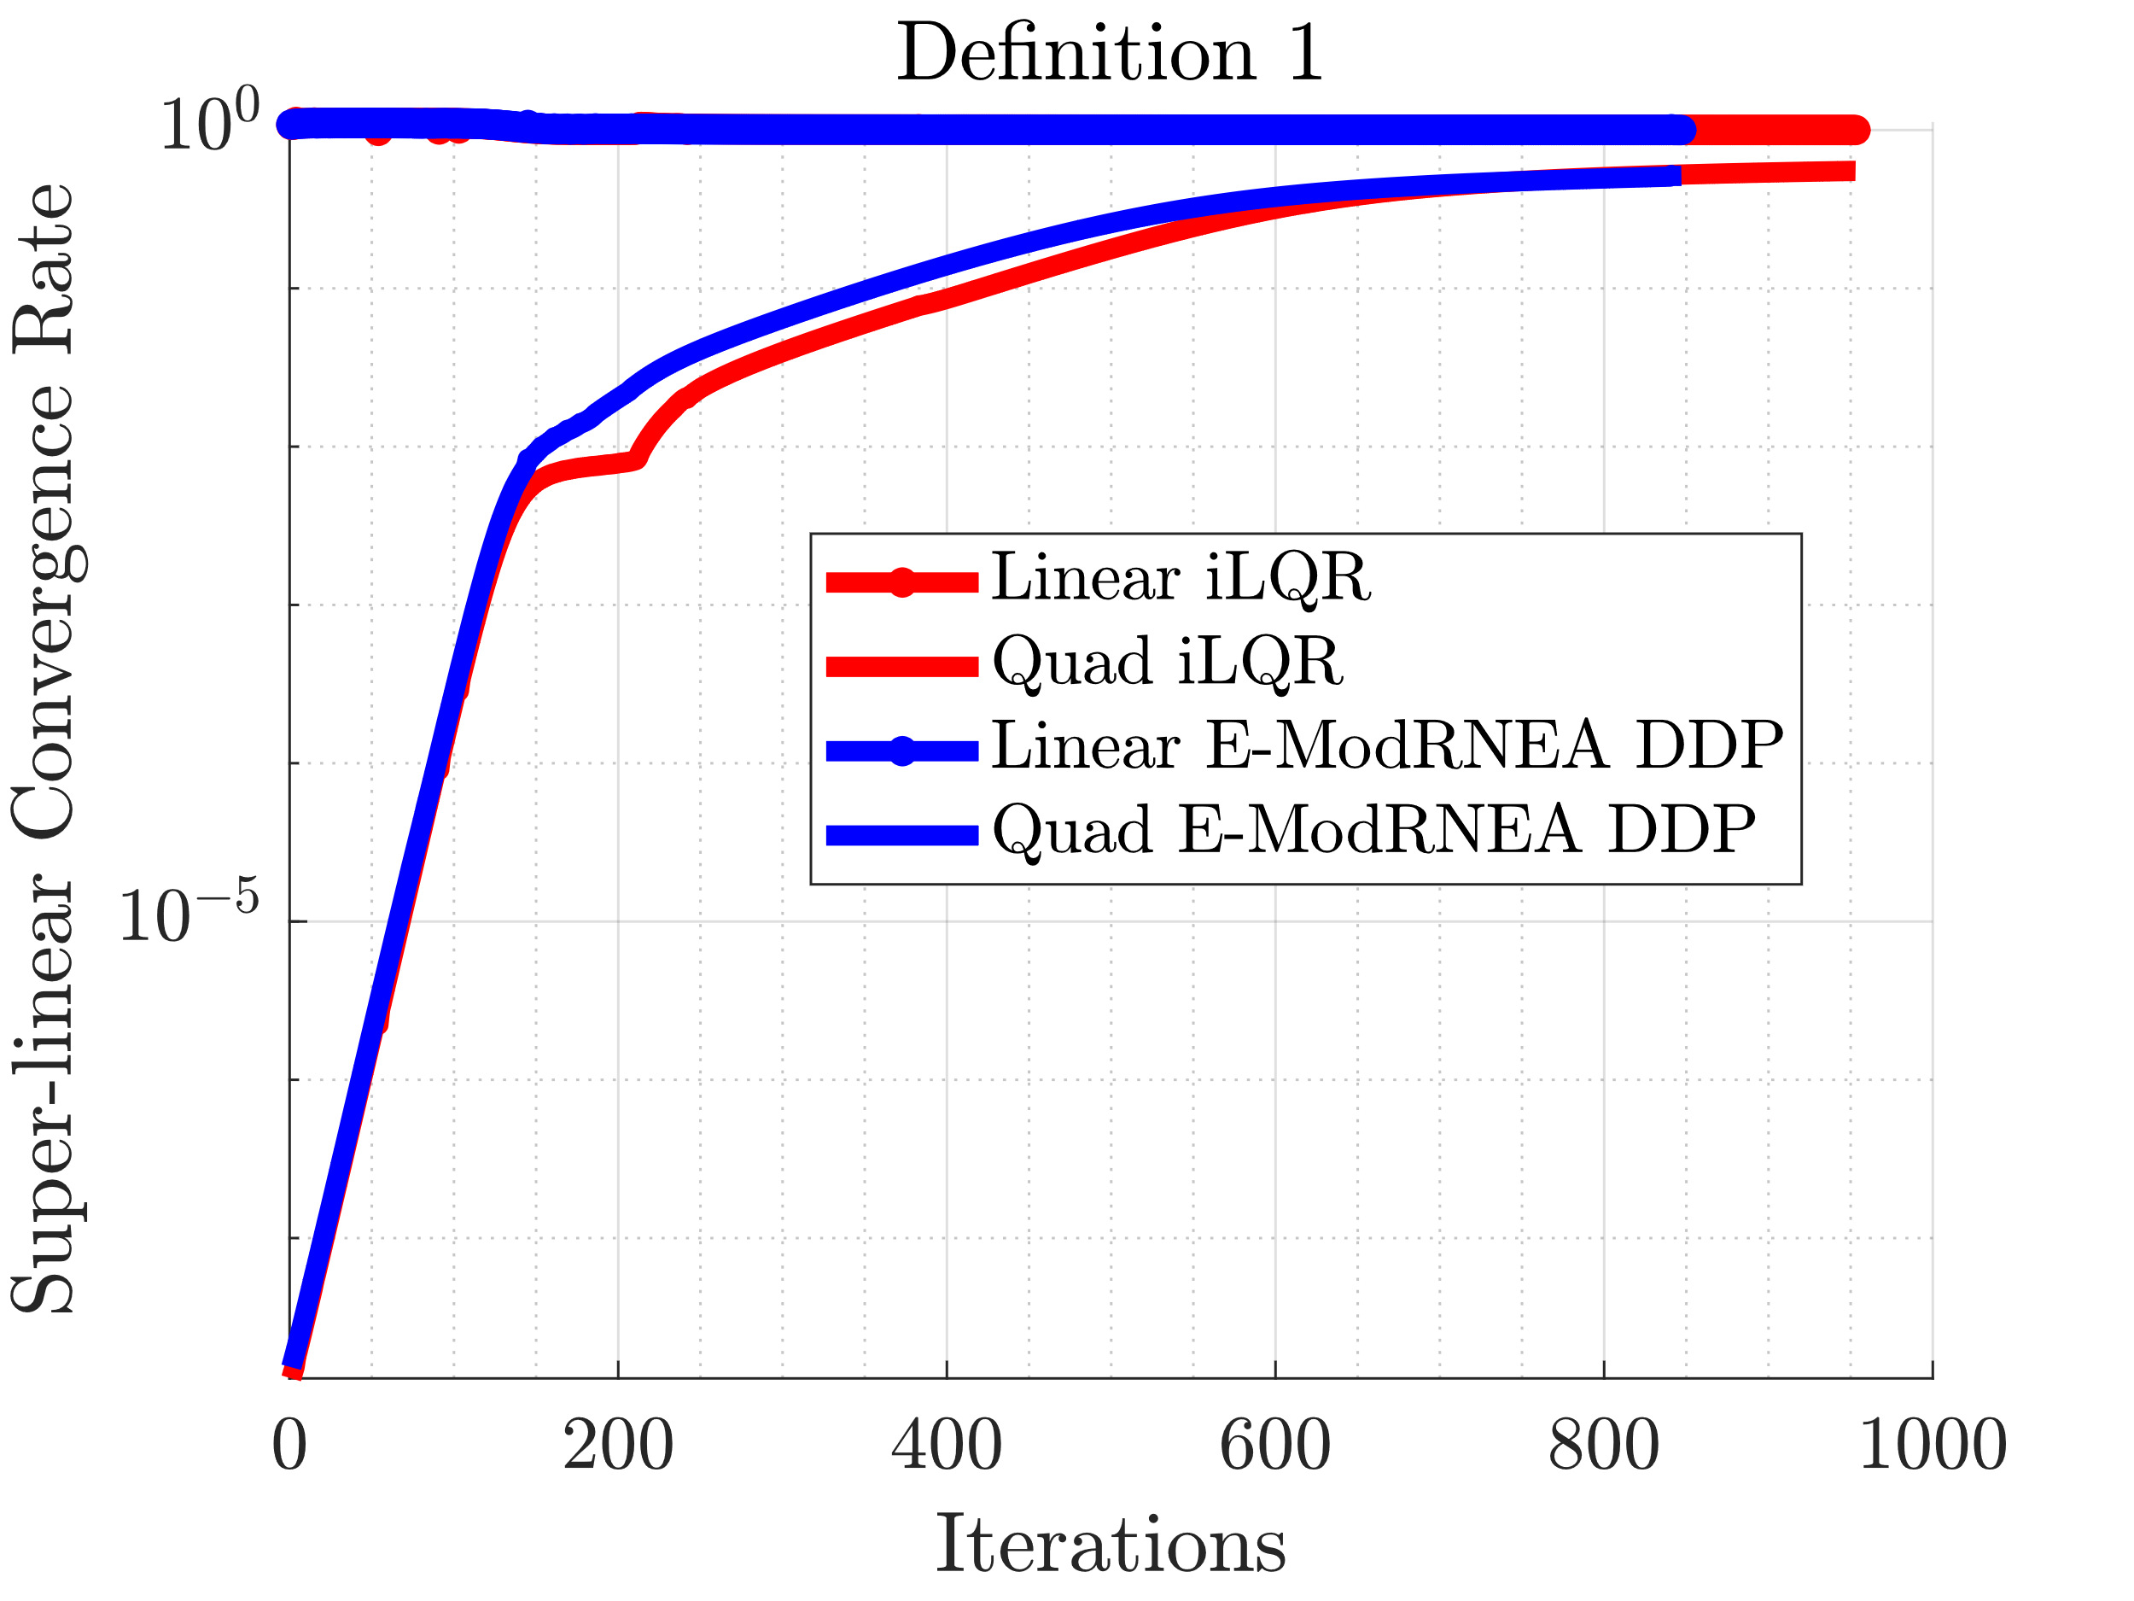
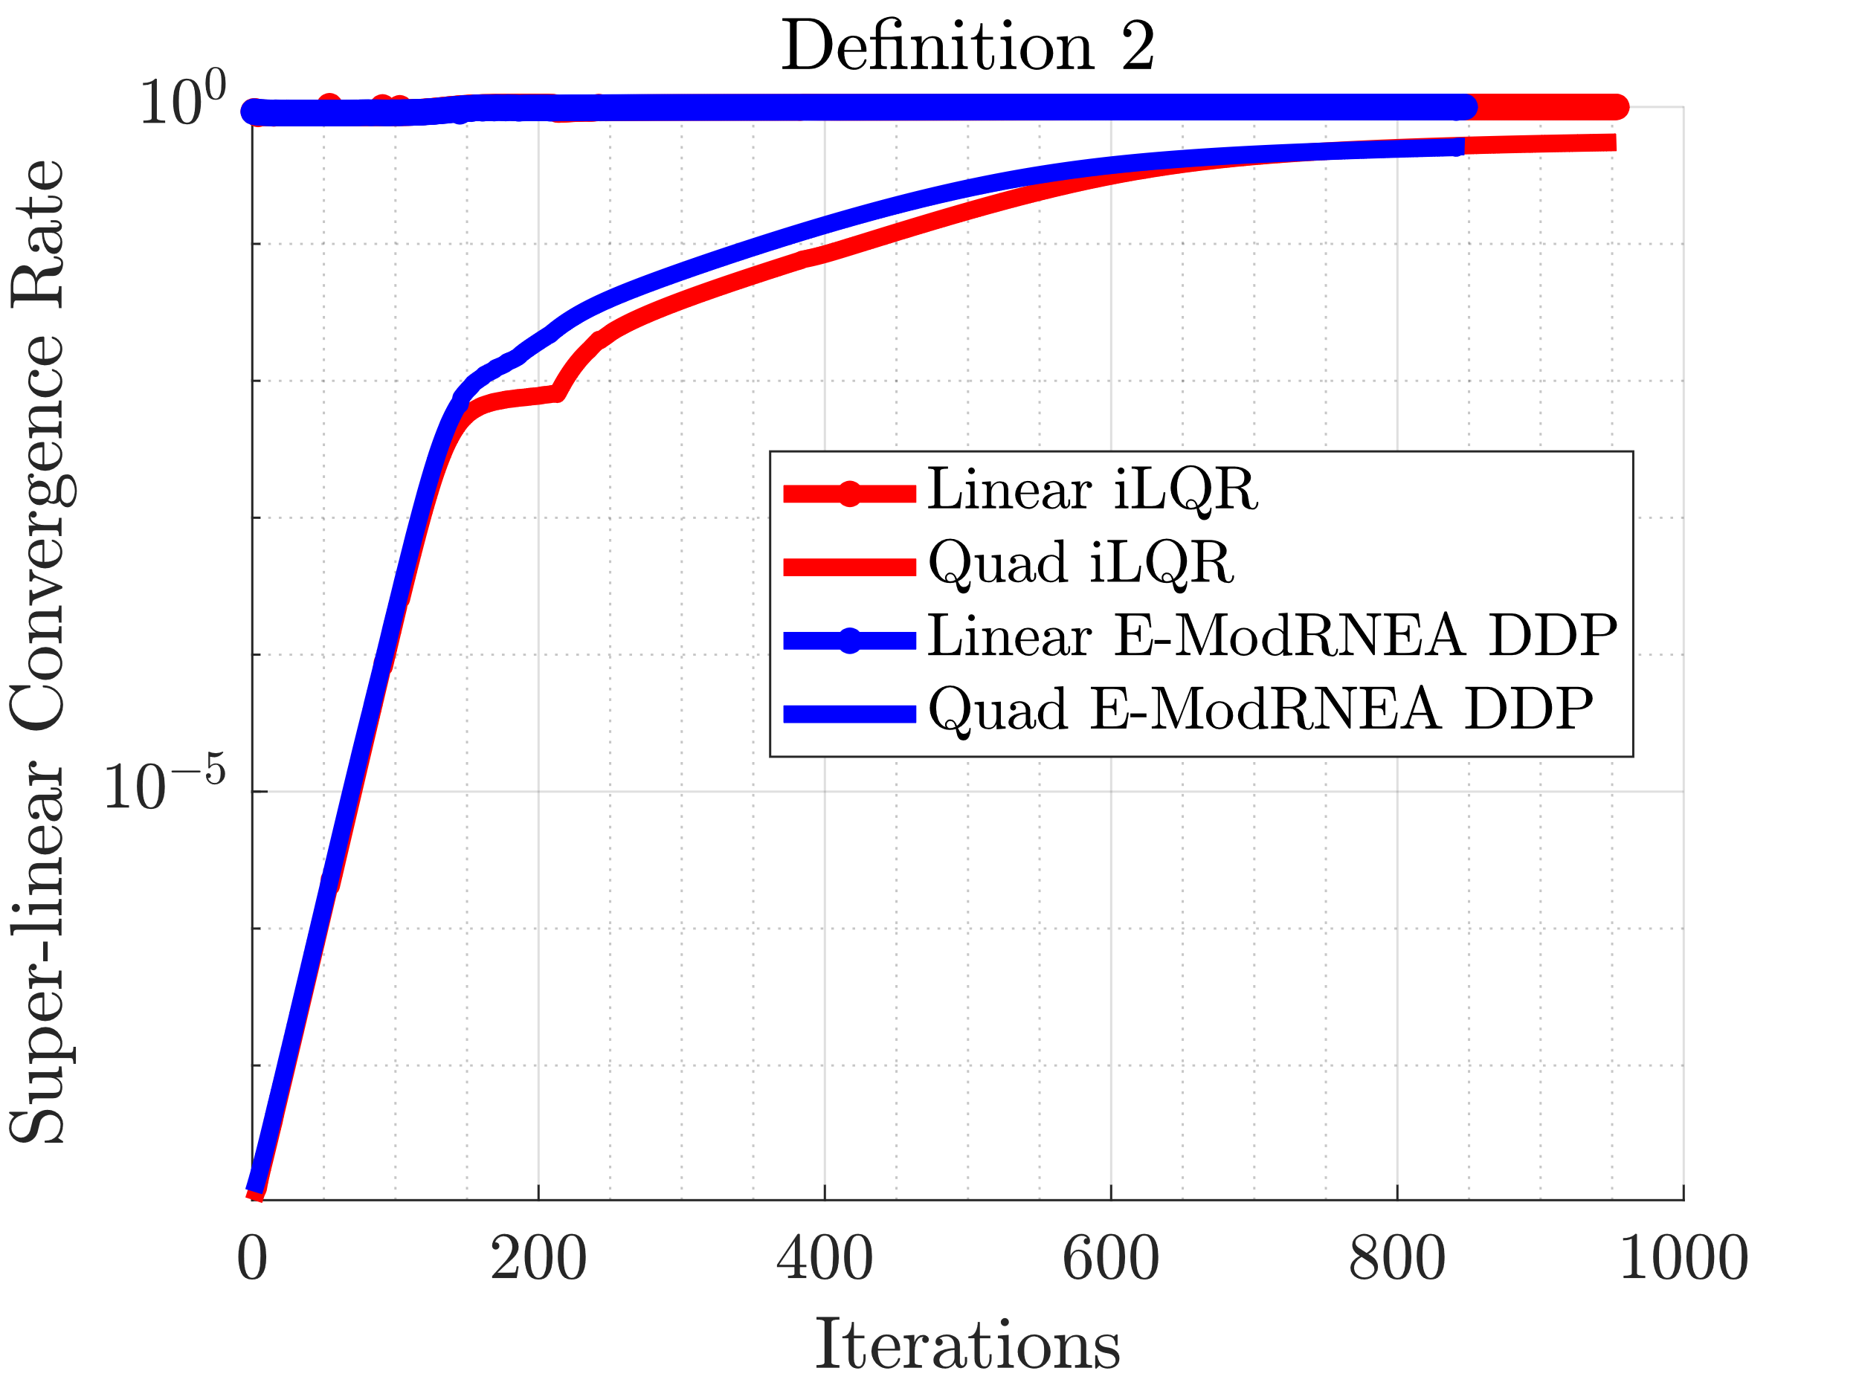
Convergence Rate: Compare with Previous Optimal

Slide 22
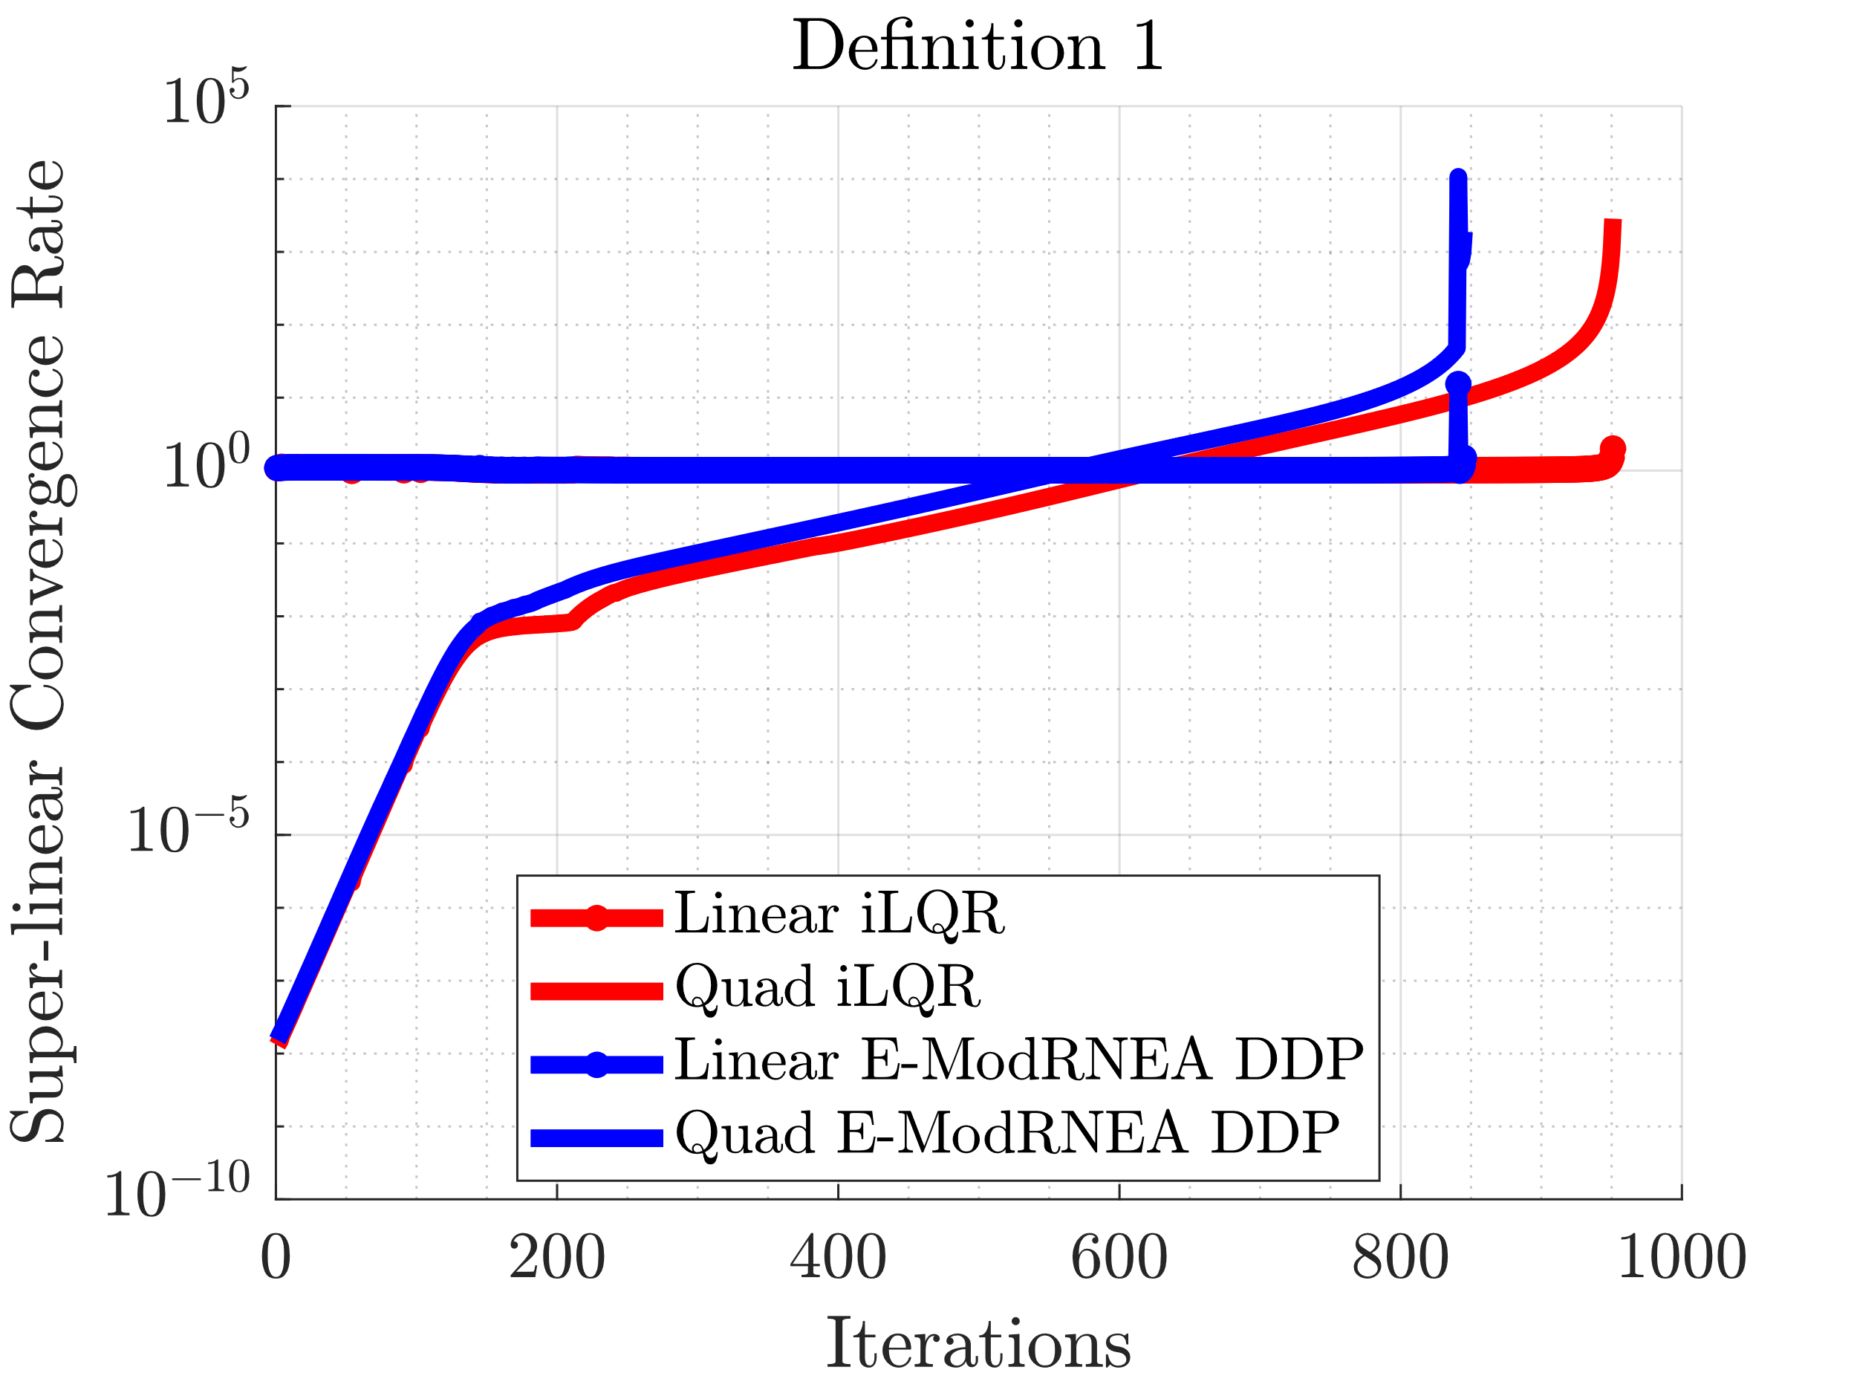
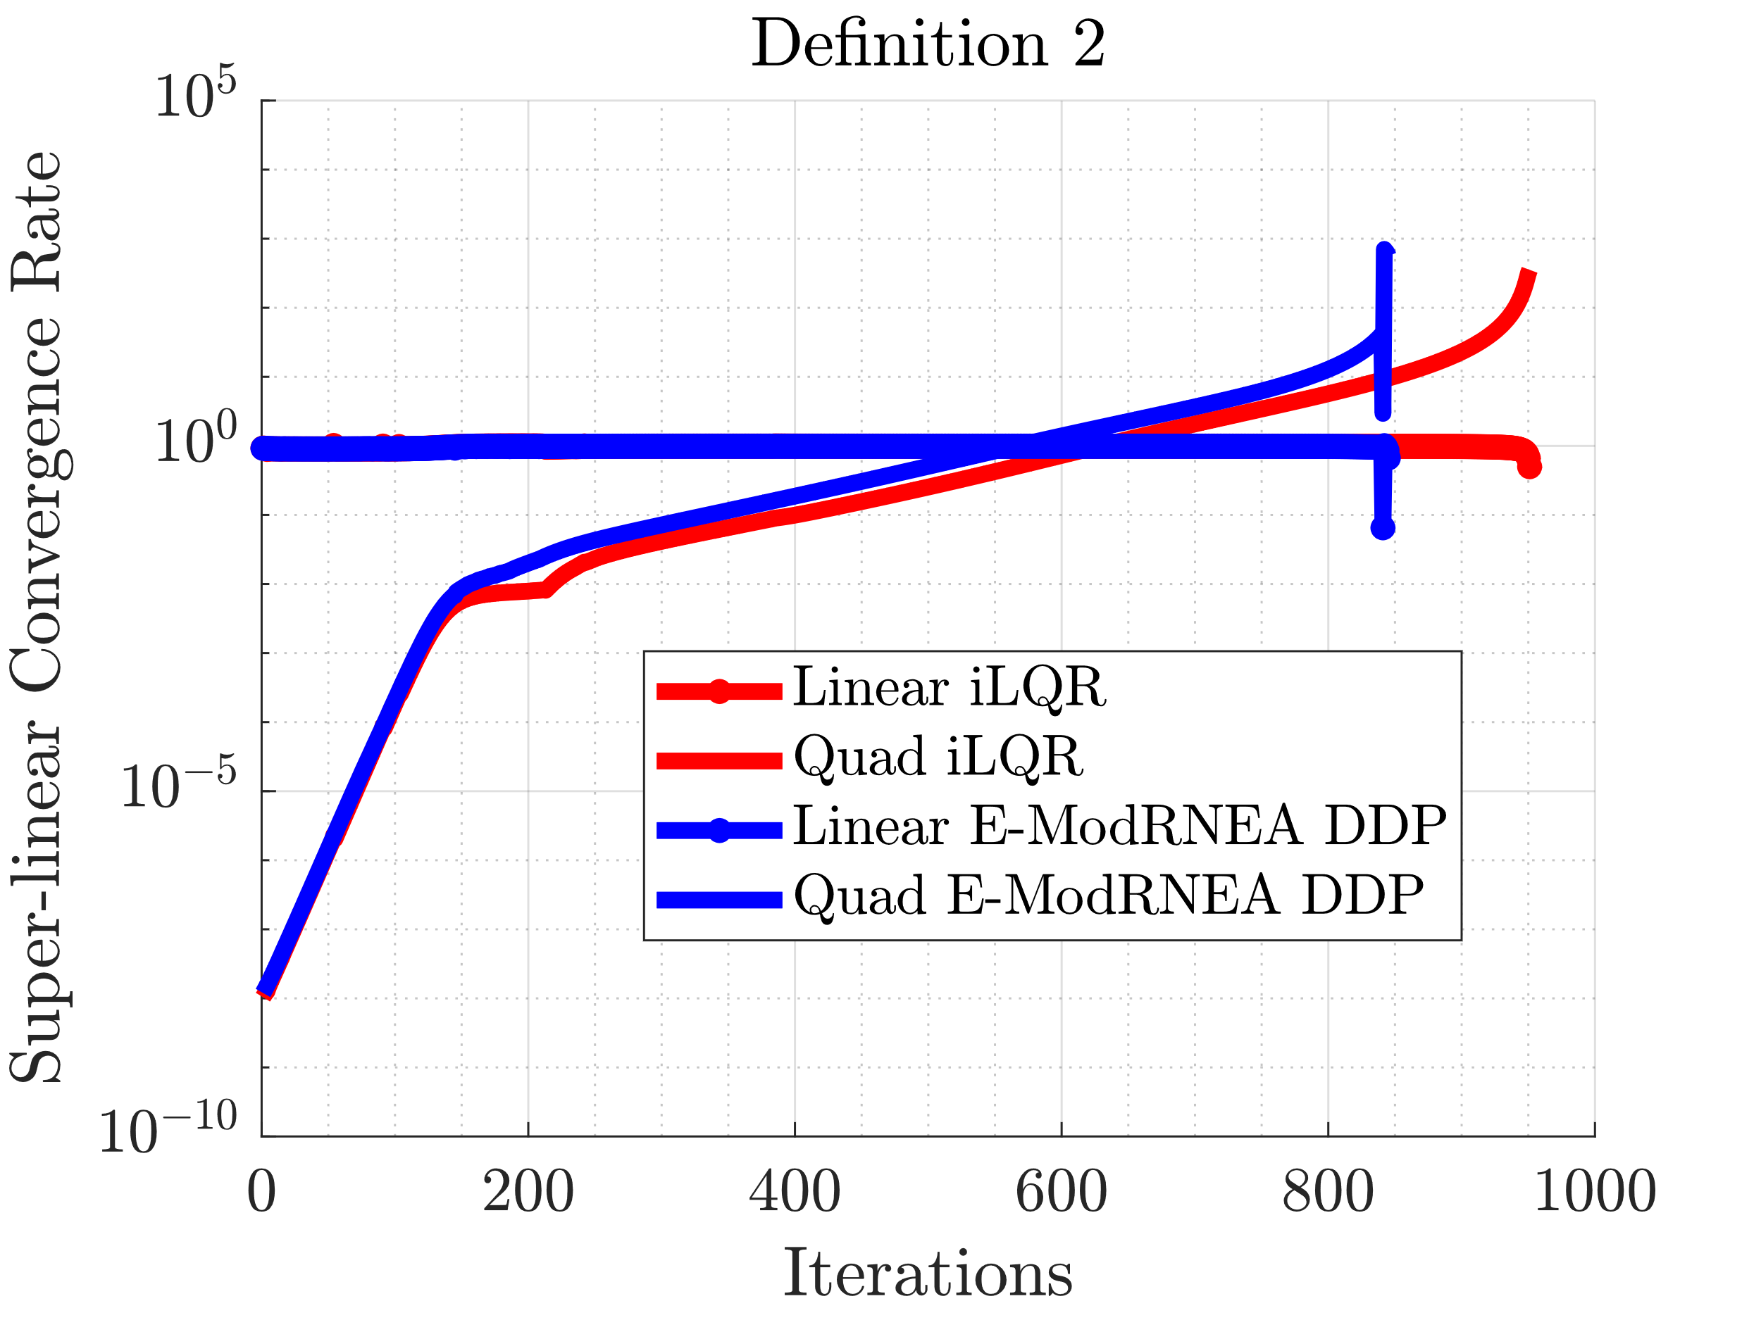
Convergence Rate: Compare with Self

Slide 23

Large Control Noise, Zero State Noise
iLQR
DDP
Noise Multiplicative = 50
After running full iLQR/DDP

Slide 24

Noising up State
Adding noise to state
Resulting motion before optimization

Slide 25
THESE RESULTS ARE OLDER
Before adding regularization
No noise on states
CRC taking some time

Slide 26
Short Run with Noise

Slide 27
Add noise to Optimized Control Trajectory
Use optimized trajectory and control as initial guess
Add weiner noise to controller
Run either iLQR/DDP for 20 iterations
Noise scaling
scaler = linspace(-2,2,15);
N = 585; dt = 1e-3;
dW = sqrt(dt)*randn(4,N); %weiner noise
W = cumsum(dW) * scaler(i);

Slide 28
Add Noise to Trajectory
Trajectory
Control
Initial
Intermediate
Optimal
Control
Trajectory
Noise * Scalar
Run either iLQR/DDP for 20 iterations

Slide 29
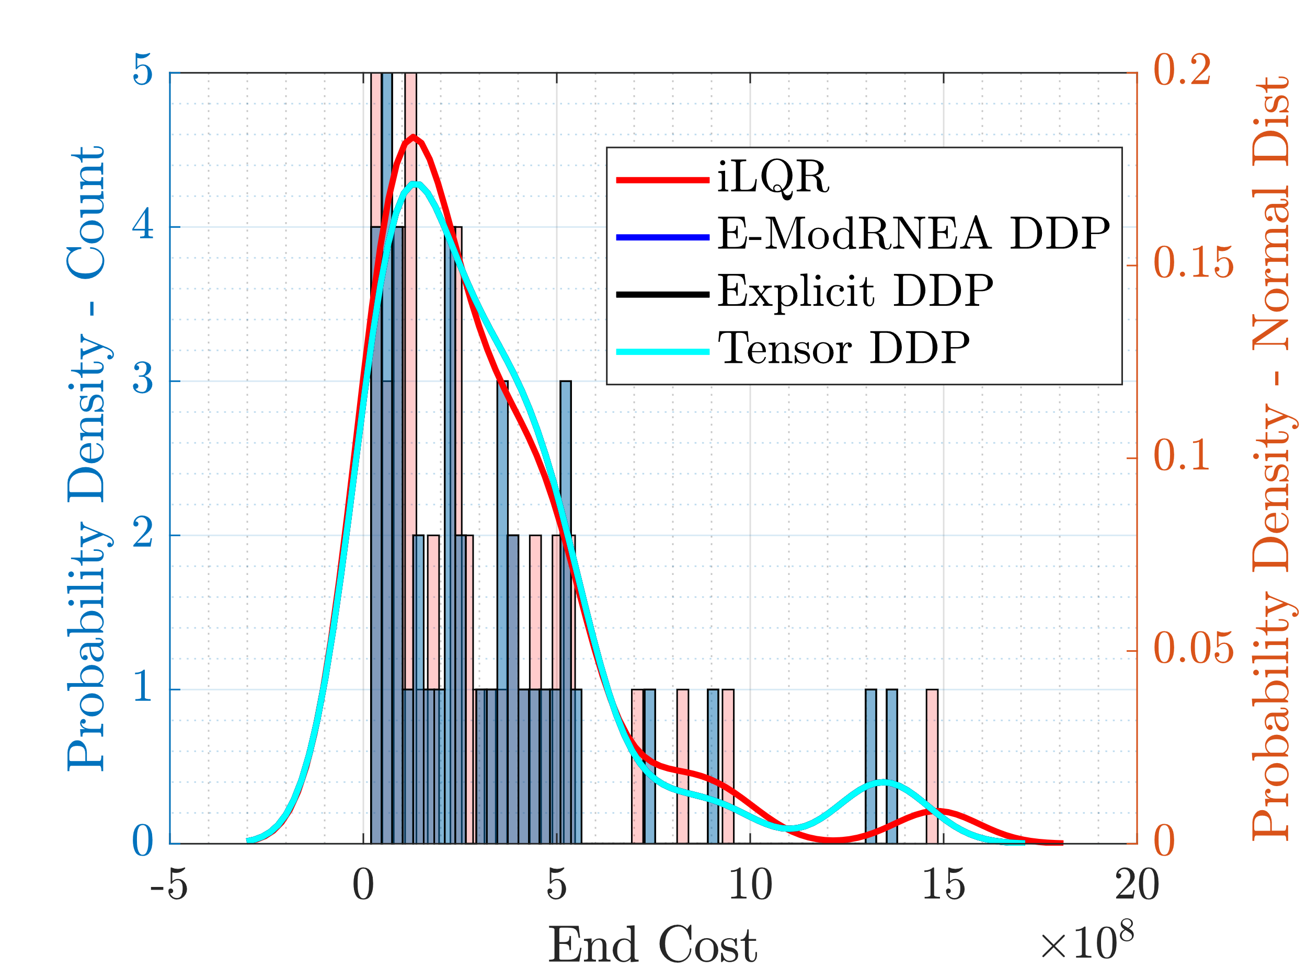
End Cost Distribution

Slide 30
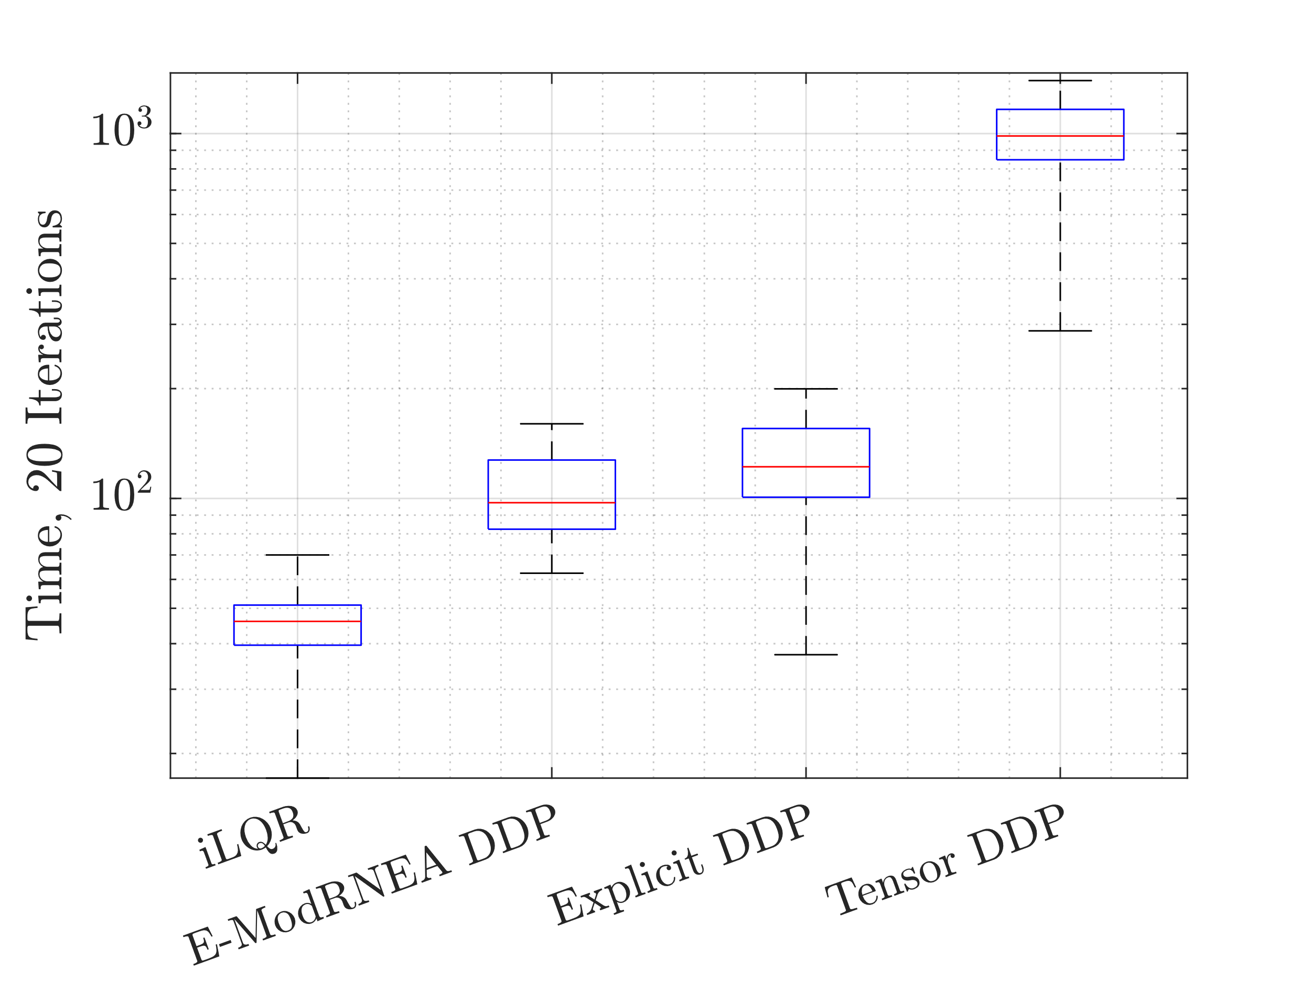
Time

Slide 31
Add noise to control
Use optimized trajectory and control as initial guess
Add weiner noise to controller
Run either iLQR/DDP for 150 iterations
Noise
N = 585; dt = 1e-3;
dW = sqrt(dt)*randn(4,N); %weiner noise
W = cumsum(dW);

Slide 32
Working on
Waiting on CRC
Editing paper

